Slide 1
Exercise 2

Slide 2
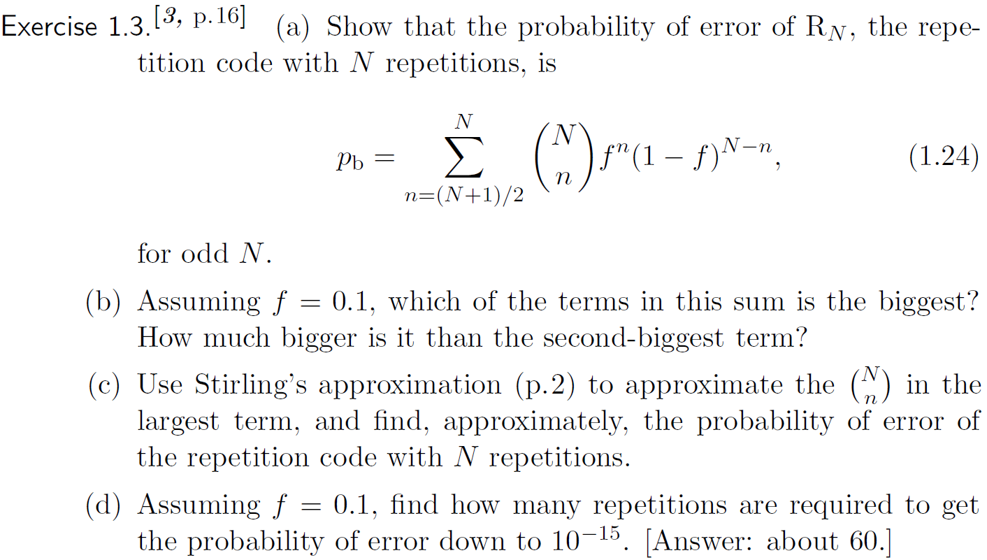

Slide 3
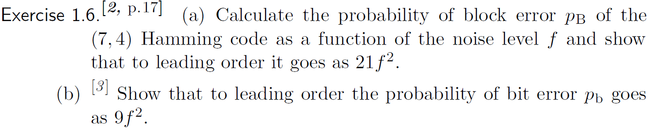
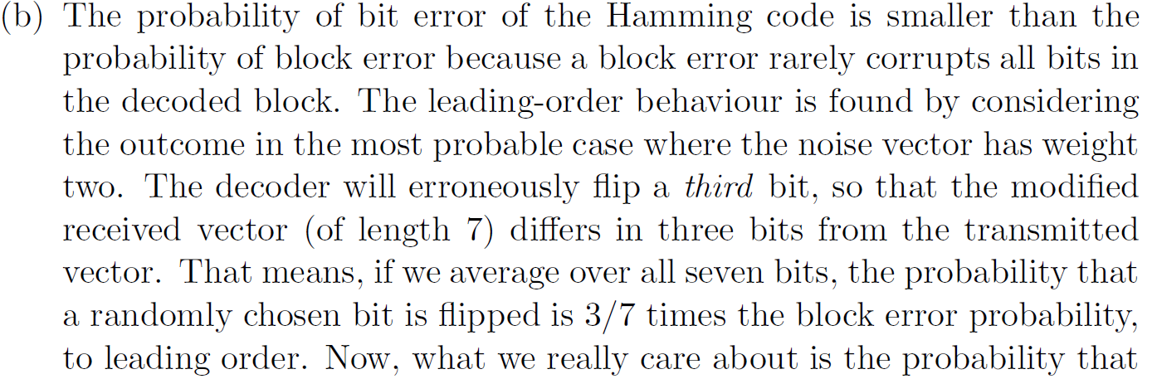

Slide 4
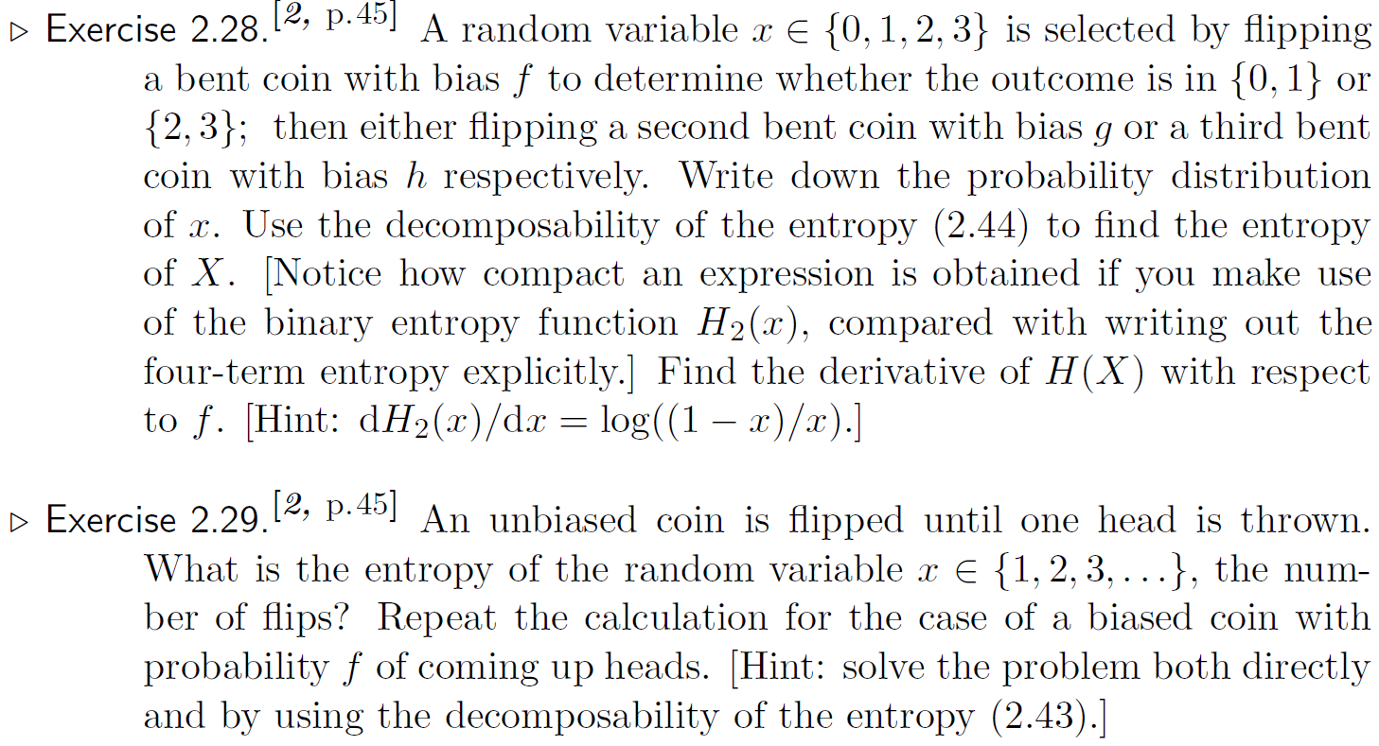

Slide 5
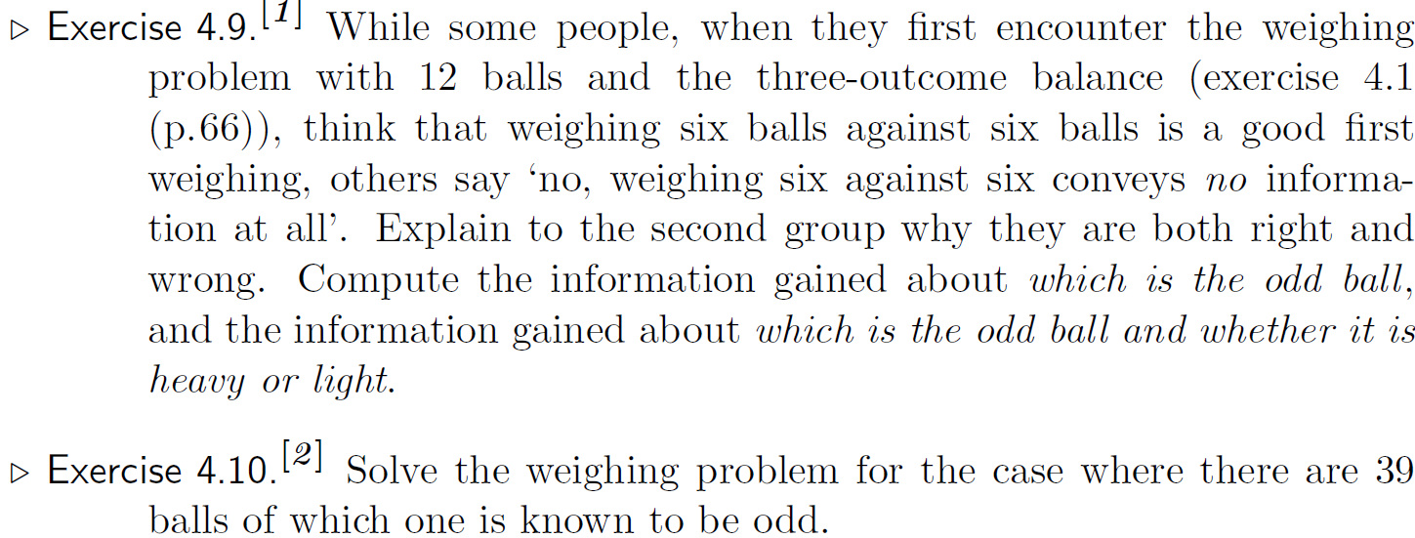

Slide 6
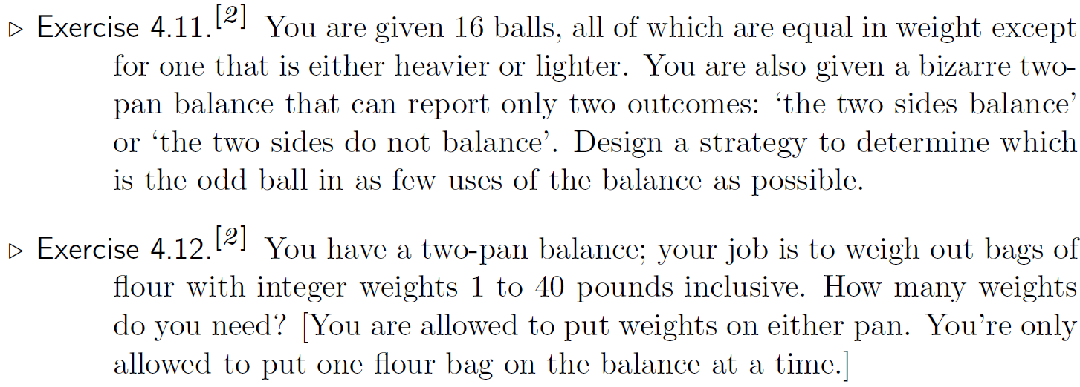

Slide 7
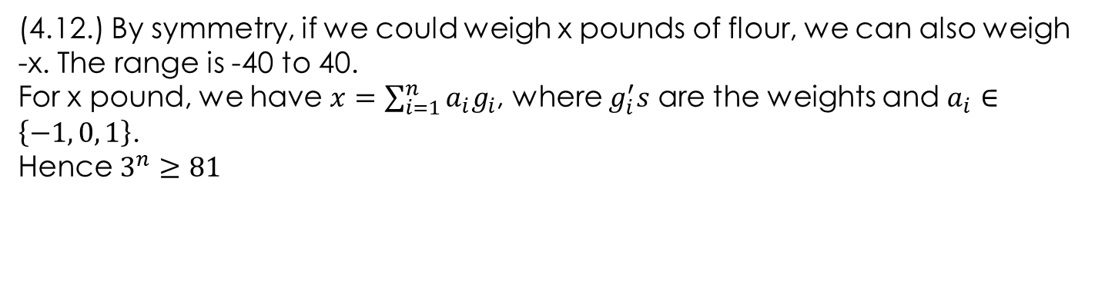
(4.12.) By symmetry, if we could weigh x pounds of flour, we can also weigh -x. The range is -40 to 40.
For x pound, we have $x=\sum_{i=1}^{n}{a_{i}g_{i}}$, where $g_{i}^{′}s$ are the weights and $a_{i}∈\left\{−1, 0, 1\right\}$.
Hence $3^{n}≥81$

